Slide 1
Java SE 17 – Presentation
Chapter 8 – Lambdas and Functional Interface

Slide 2
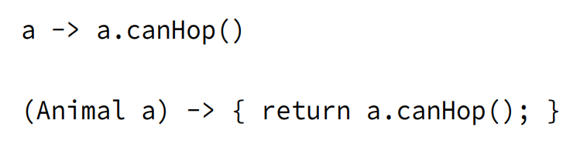
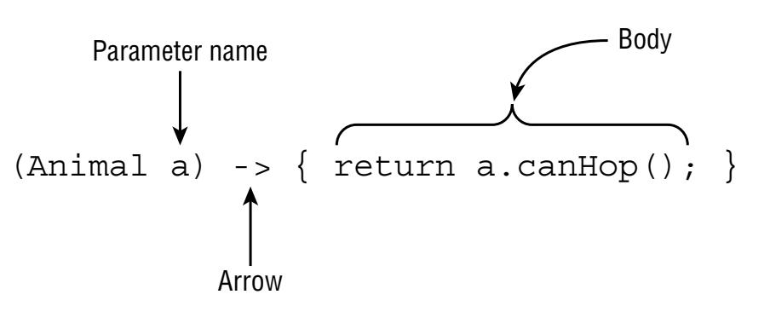
Revision
- We can understand Lambda as ... in a ... class
- Note: We can only use Lambda with ...
(code illustration snippet 1,2,3,4)
- Deferred execution is ...

Slide 3
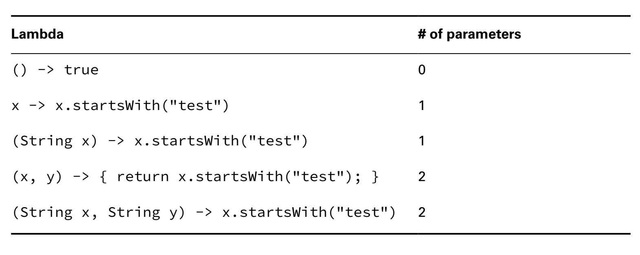
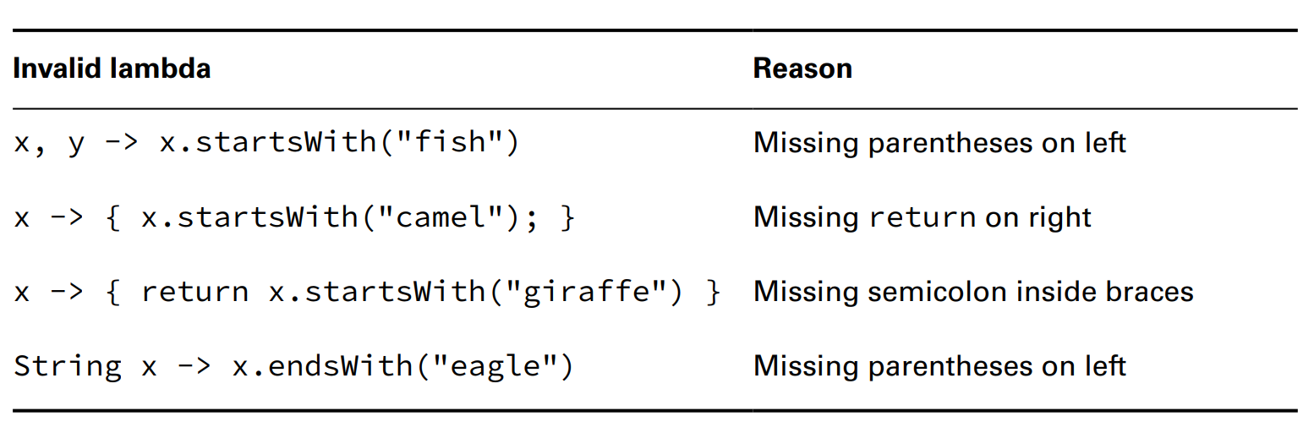
Revision

Slide 4
Revision
Assigning Lambdas to var
- We ... assign ... to var because ... lambda needs
Coding Functional Interface
- As we know that we can only use ... with ...
- ... is offically called ... (... only has ...)
Defining a Functional Interface
(code illustration snippet 5)
- The annotation ... will ... that this interface will ... If the interface doesn't ...
(code illustration snippet 6)
- Java includes the ... some ... however not ...
– An interface without ... doesn't mean ... Remember that ...
(code illustration snippet 7)

Slide 5
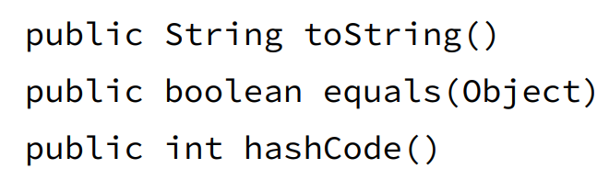
Revision
Adding object methods
- There is a rule in ... that if a ... declares ... that is the same ... => that ... won't be considered as ... interface
- Note: JLS allows ... from ... class to ... from ... interface... with some rules
+)
+)
+)
- However, JLS also points out that if the ... is from ... class => another rule must be satisfied which is ...
(code illustration snippet 8)

Slide 6
Revision
Using Method Reference
- Method Reference is ...
(code illustration snippet 9)
- However, that syntax is ..., therefore, we can ...
(code illustration snippet 10)
- The colons are used for ...
– There are ... types of Method Reference
+)
+)
+)
+)
Calling static method
(code illustration snippet 11)
- How does Java know to pick ..., it is because the ... in ... class ...

Slide 7
Revision
Calling Instance methods on a particular object
(code illustration snippet 12)
- Method reference doesn't require ... but with ... conditions, which are ... and ...
(code illustration snippet 13)
(code illustration snippet 14)
Calling instance methods on a parameter
- In this section, we will use ... with ... in ... interface ....
- The trick here is that we won't ...
- The only condition to ... is the ... must ...
(code illustration snippet 15)
- Also we can combine ...
- The first ... will be ... and the second ... will be ...

Slide 8
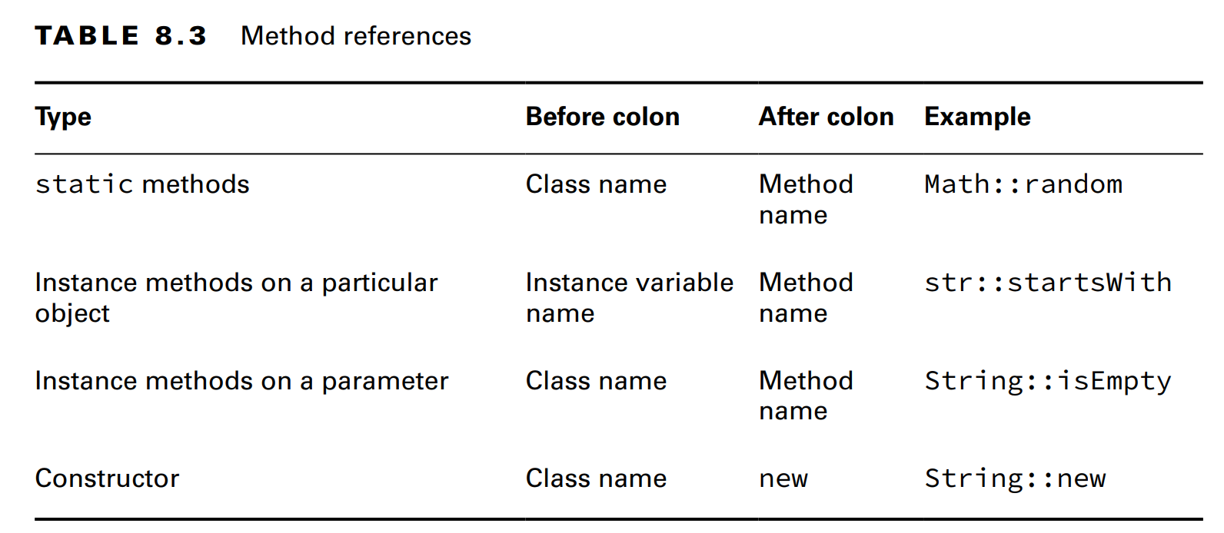

Revision
(code illustration snippet 16)
Calling Constructor
- ... reference is a special ... because instead of using ... it uses ... and it ... instead of ...
(code illustration snippet 17)
- If the ... method has ... => ... reference will ... it
(code illustration snippet 18)

Slide 9
Revision
Working with built-in functional interfaces
- Sometime it will be … for us to … lambda …
- Luckily most of them ….
– Some of the core … has been … in package …. We will talk about ... in the next chapter but for now we will understand this:
T
U
R

Slide 10
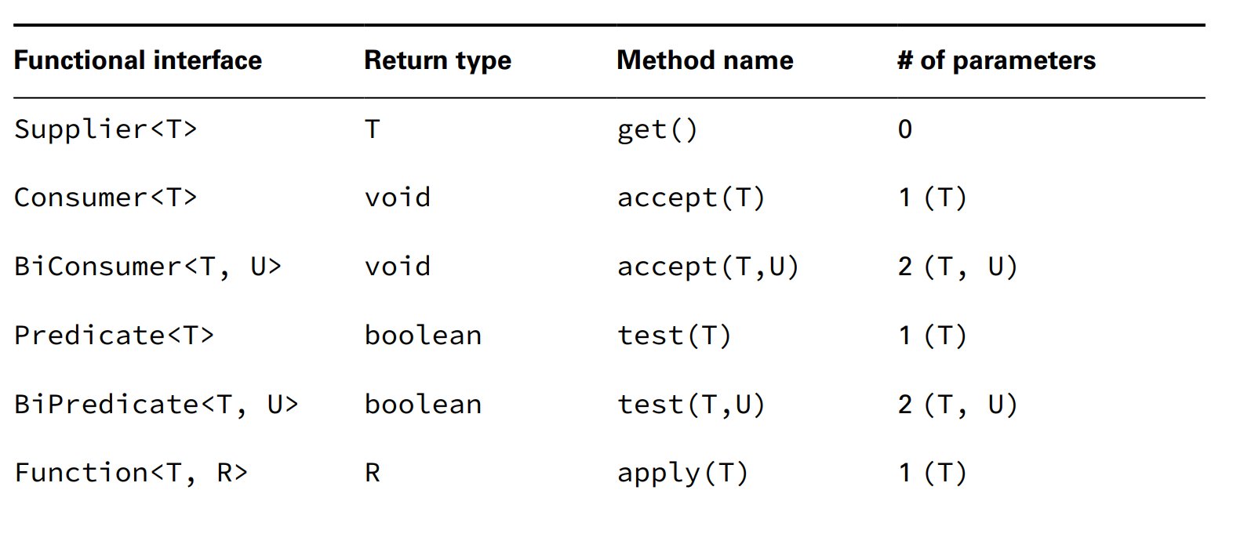
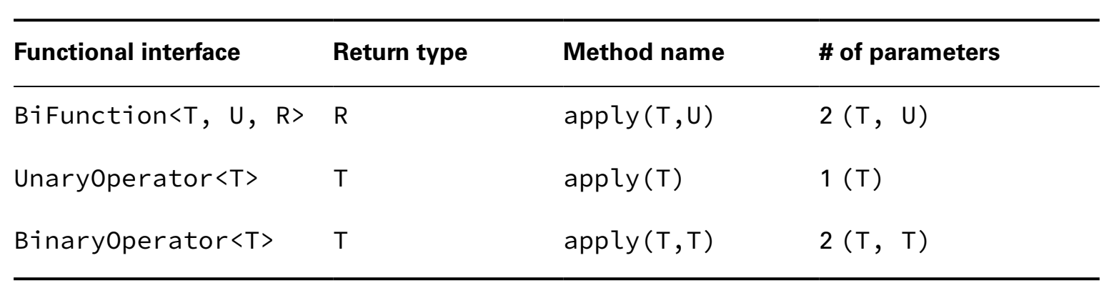


Revision

Slide 11
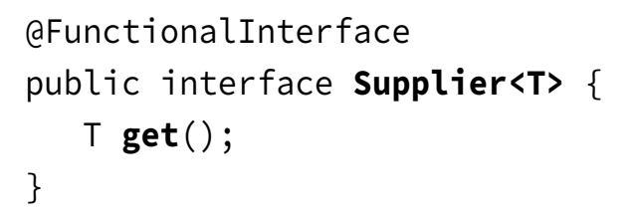
Revision
- For the exam, we have to ...
We are not usually ... variable ... define it and ...
Implementing Supplier
We use Supplier when ... with no ...
(code illustration snippet 19)
- Supplier is used to ...
(code illustration snippet 20,21)
- ... print ...
(code illustration snippet 22)
- That string has a meaning, ... is a ..., ... is a ... and the ... sign is a ...

Slide 12
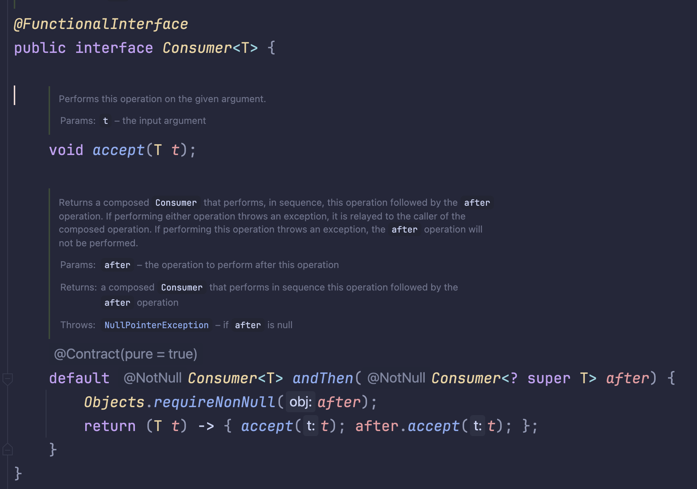
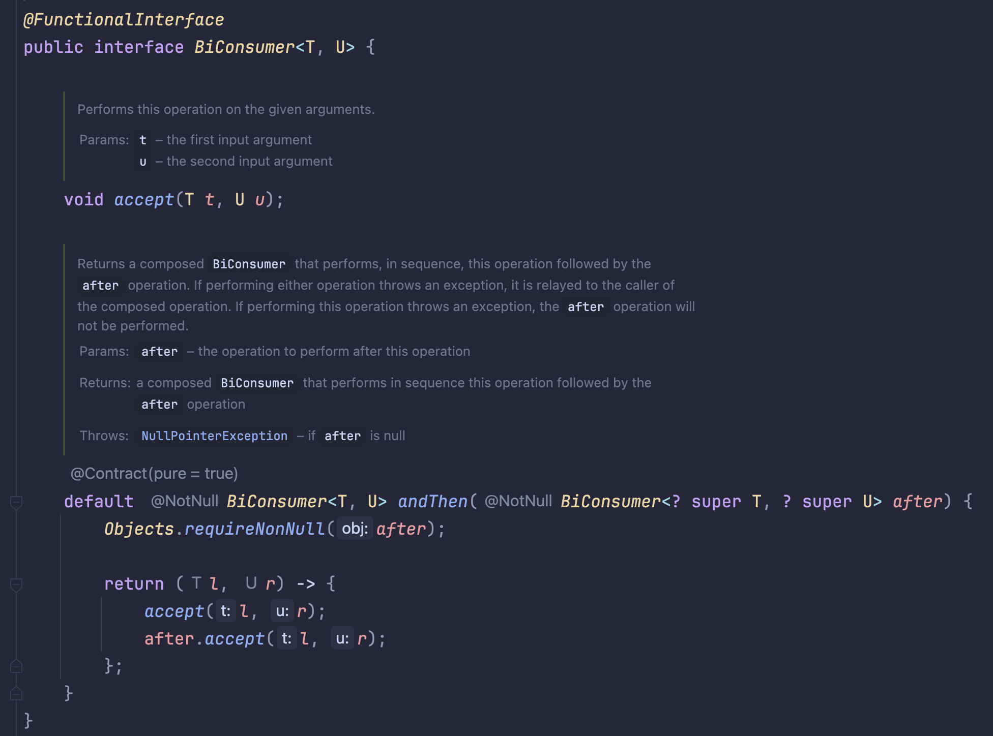
Revision
Implementing Consumer and BiConsumer
- We use Consumer when we ... but ...
- BiConsumer is ...

Slide 13
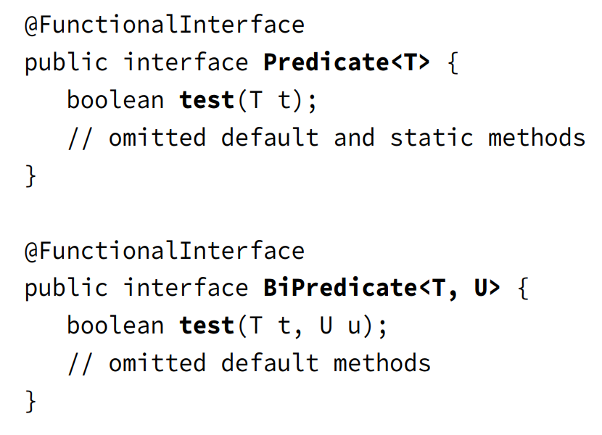
Revision
(code illustration snippet 23,24,25)
Implementing Predicate and BiPredicate
- Predicate is used to ... and ...
– BiPredicate is ...

Slide 14
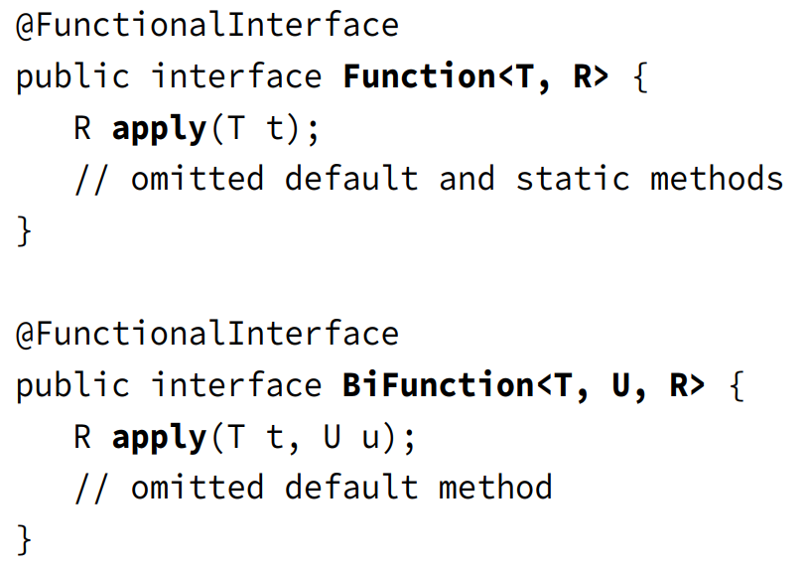
Revision
(code illustration snippet 26,27)
Implementing Function and BiFunction
- Function is used to ... that may have different ...
- BiFunction is used to ...

Slide 15
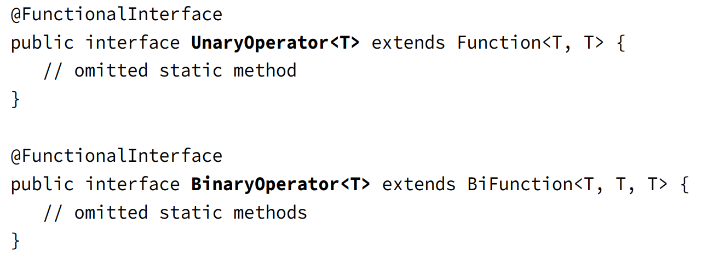
Revision
(code illustration snippet 28,29)
Implementing UnaryOperator and BinaryOperator
- UnaryOperator and BinaryOperator are a ... where they require ... same ...
– UnaryOperator will ...
– BinaryOperator will ...

Slide 16
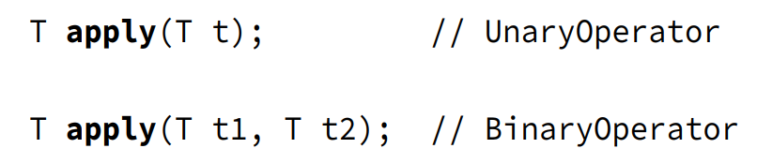
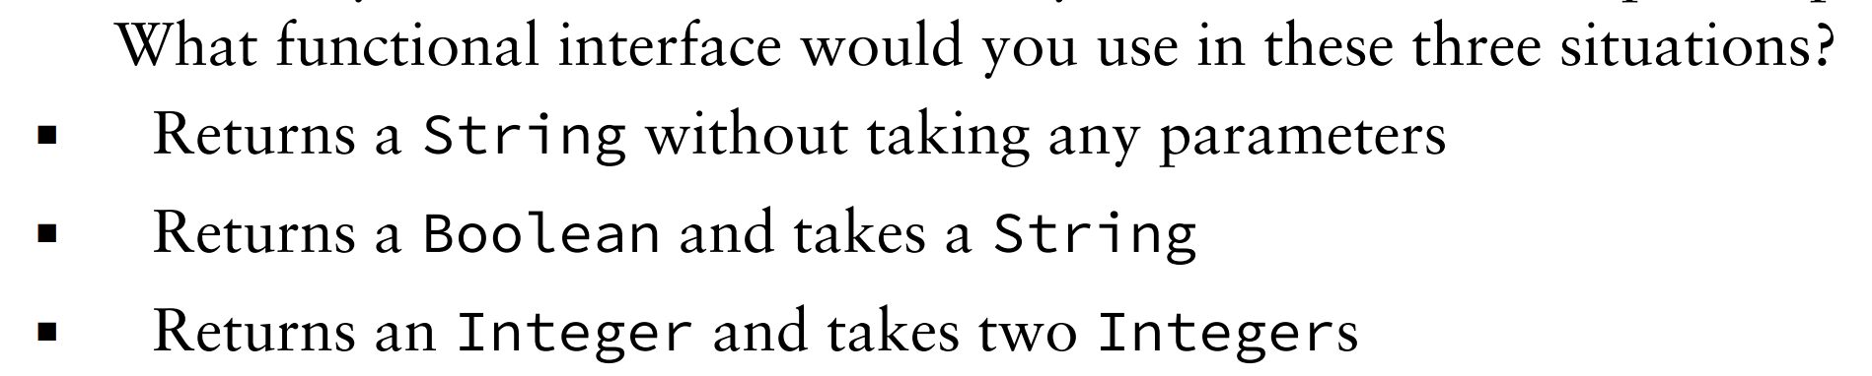
Revision
(code illustration snippet 30, 31)
Checking Functional Interface
(answer the following questions)

Slide 17
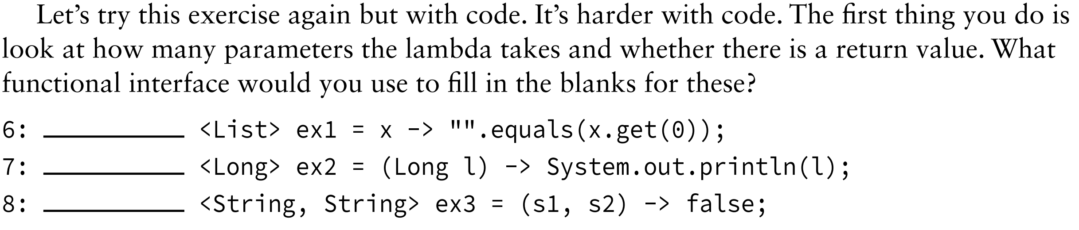
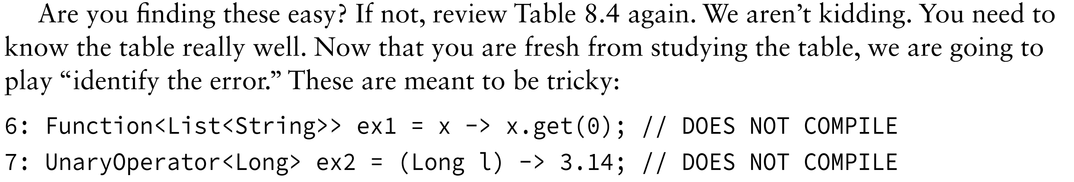
Revision
-

Slide 18
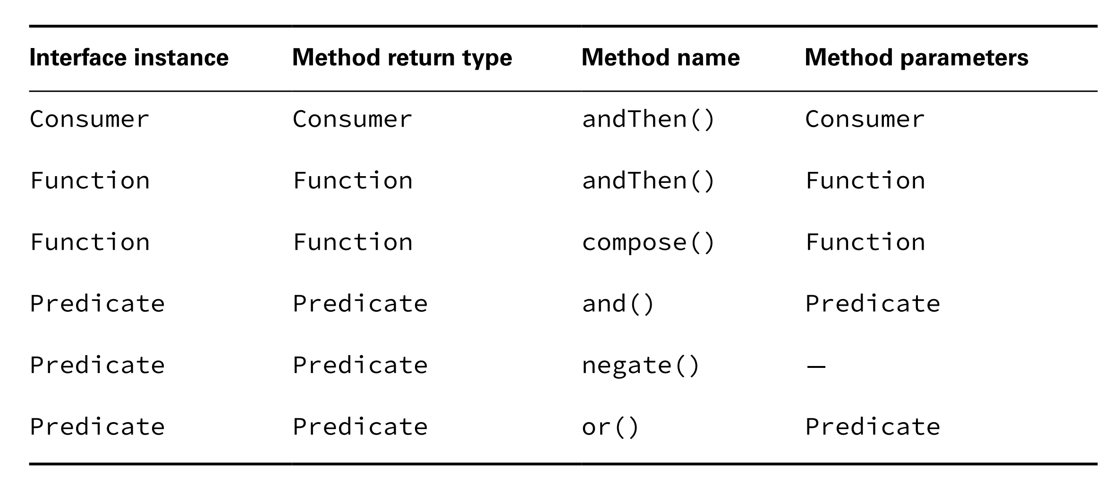
Revision
Using convenience Methods on Functional Interface
- Usually, Functional ... has ... however, they have ...
– These methods are used to ... or ... the interface
(code illustration snippet 32,33,34,35)
- With Function, it uses ... as a ... for ... => We have to make sure ...
(code illustration snippet 36)

Slide 19
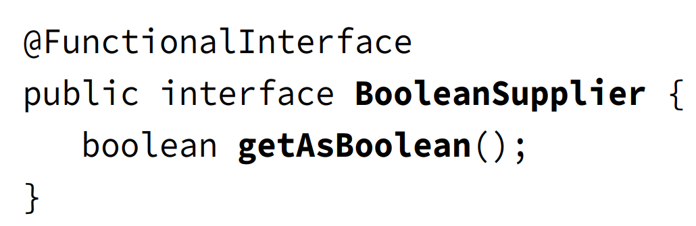
Revision
Learning the Functional Interfaces for Primitives
We also have some ... for ... These ... Stream ... Optional
Most of these ... and there is one for ...
(code illustration snippet 37)

Slide 20
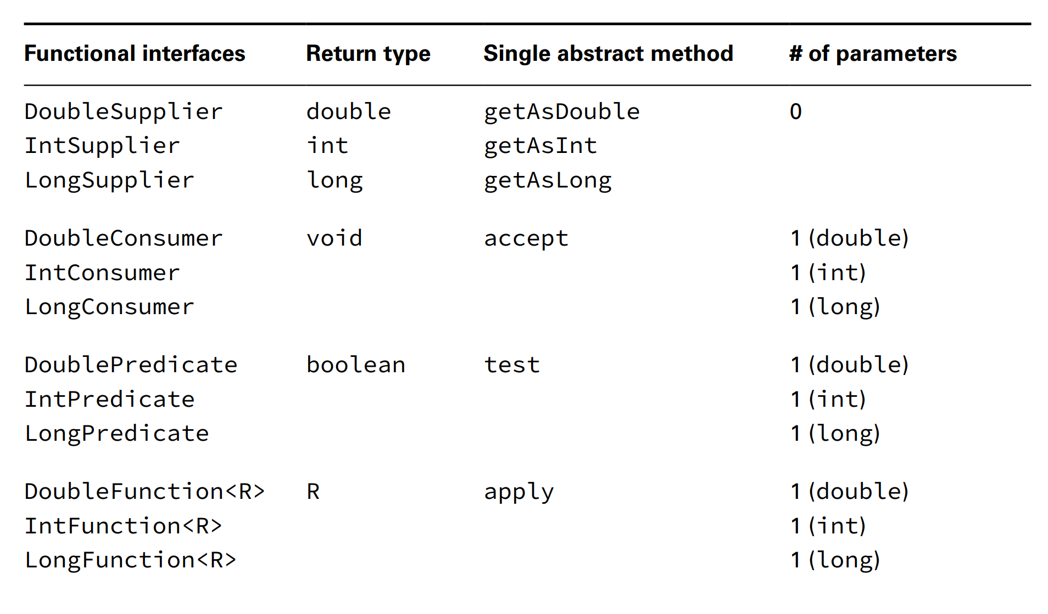
Revision

Slide 21
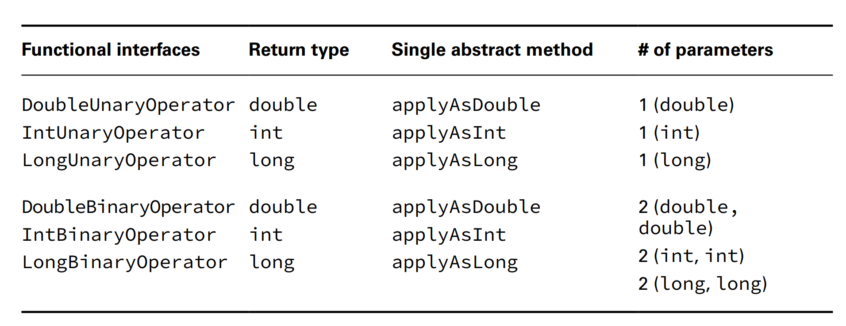
Revision

Slide 22
Revision
- There are some differences in ... However, Function still has ...
Working with Variables in Lambdas
Now we will talk about ...
Variables appear in ... places ..., ..., and ...

Slide 23
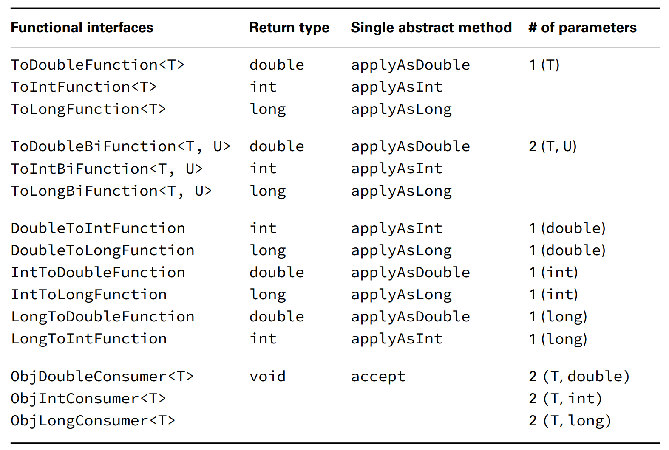
Revision

Slide 24
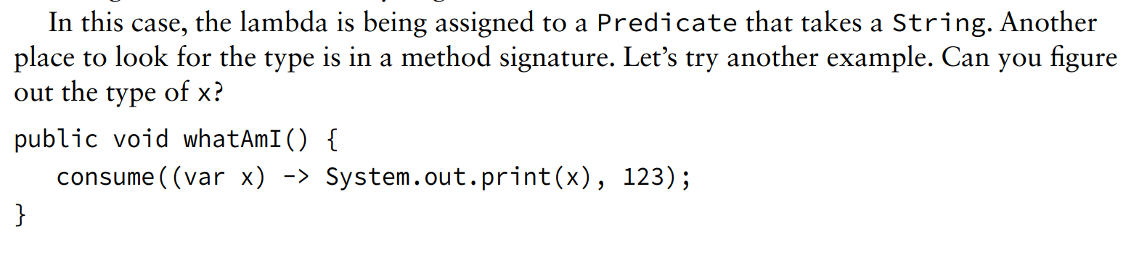
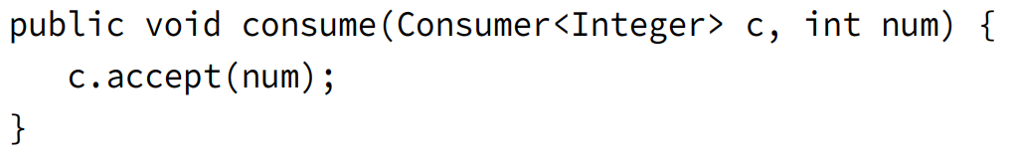
Revision
- These are all ...
- Why don’t we see ... in Function and BiFunction, it is because ...
Listin Parameters
- We already know that ... can be ommited. Now we also know that ...
(code illustration snippet 38)
(answer the following question)

Slide 25
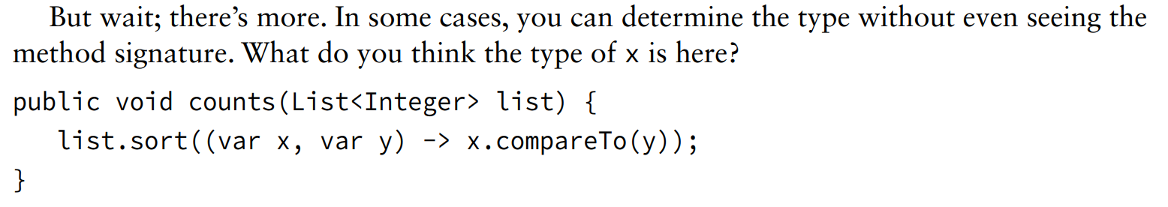
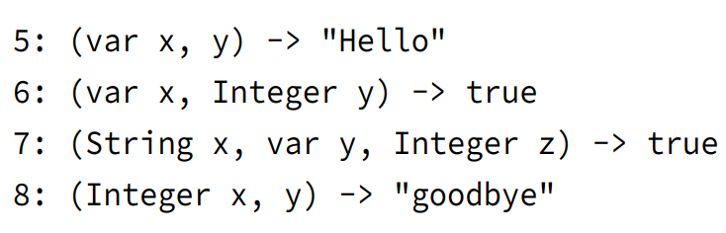
Revision
-
- Because ... is like normal ... => we can use ... on it
(code illustration snippet 39)
- However, lambda requires ... format ...
(code illustration snippet 40)

Slide 26
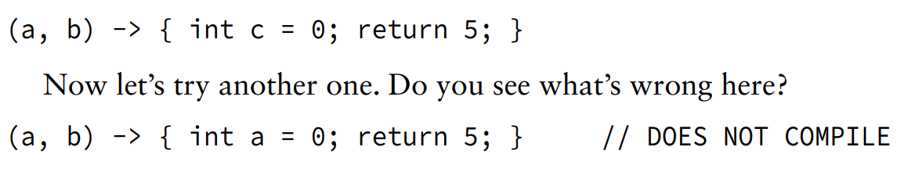
Revision
Using local variables inside a lambda body
Lambda expression usually ... but it still allows us to ...
(code illustration snippet 40)
- In general, we should keep ... because long ...
- In the book, there is a special example about method reference (code illustration snippet 41)
Referencing variables from the lambda body
(code illustration 42,43)

